Slide 1


Data Science & ML
in Telecommunication Industry
Dinar Syahid Nur Ulum
Data Scientist at Telkom Indonesia

Slide 2
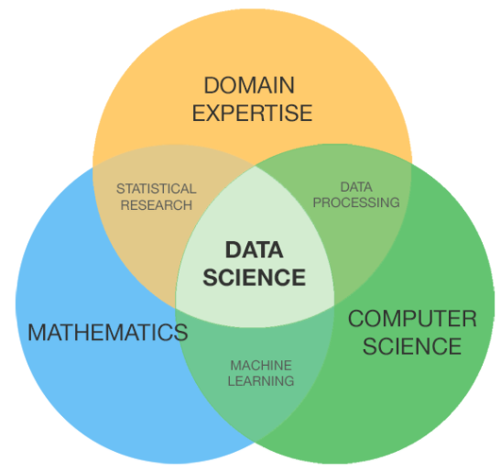
What is Data Science?
Data science is a multi-disciplinary field that uses scientific methods, processes, algorithms and systems to extract knowledge and insights from structured and unstructured data. (wikipedia.org)

Slide 3
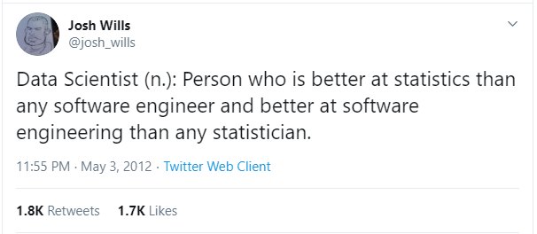
Who is Data Scientist?

Slide 4
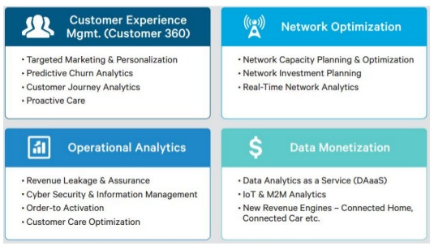
Big Data and Data Science in Telecom
Source : https://arxiv.org/pdf/1702.02823.pdf

Slide 5
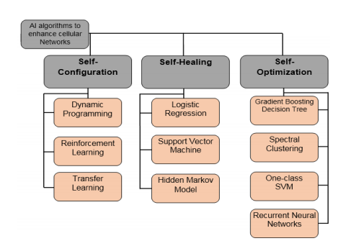
AI Algorithms for SON
Source : https://arxiv.org/pdf/1702.02823.pdf

Slide 6
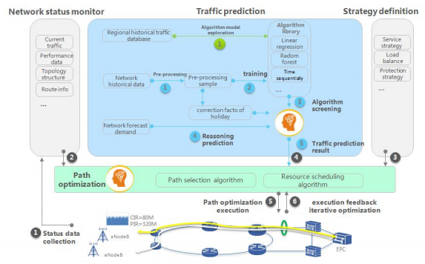
Smart traffic prediction and path optimization
Source : https://res-www.zte.com.cn/mediares/zte/Global/Solutions/AI_Enables_Network_IntelligenceZTE_AI_WhitepaperEN.pdf?la=en

Slide 7
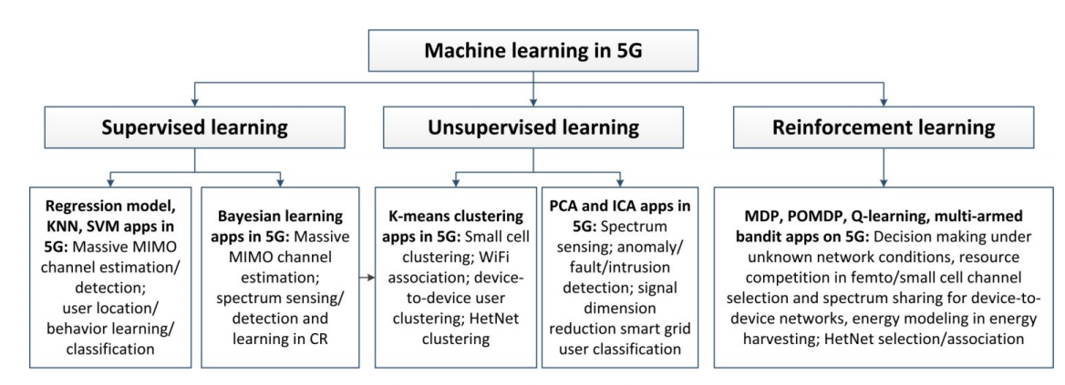
Machine Learning in 5G
Source : https://www.itu.int/dms_pub/itu-t/opb/proc/T-PROC-KALEI-2018-PDF-E.pdf

Slide 8
Machine
Learning
Machine Learning is the field of study that gives computers that capability to learn without being explicitly programmed. ML is one of the most exciting technologies that one would have ever come across. As it evident from the name, it gives the computer that which makes it more similar to human: The ability to learn. Machine learning is actively being used today, perhaps in many more places than would except.
Traditional Programming
Machine Learning
Data
Computer
Data
Computer
Output
Program
Program
Output

Slide 9
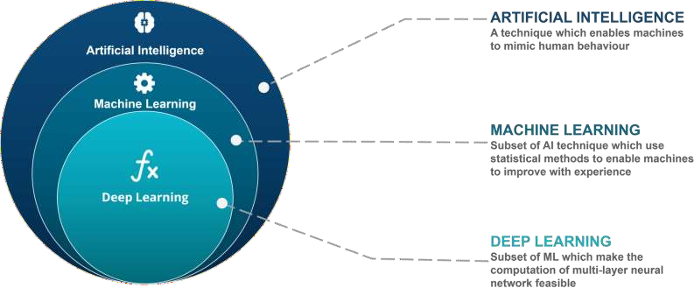
Data Science
DATA SCIENCE
Apply AI, ML and DL techniques to create actual products

Slide 10
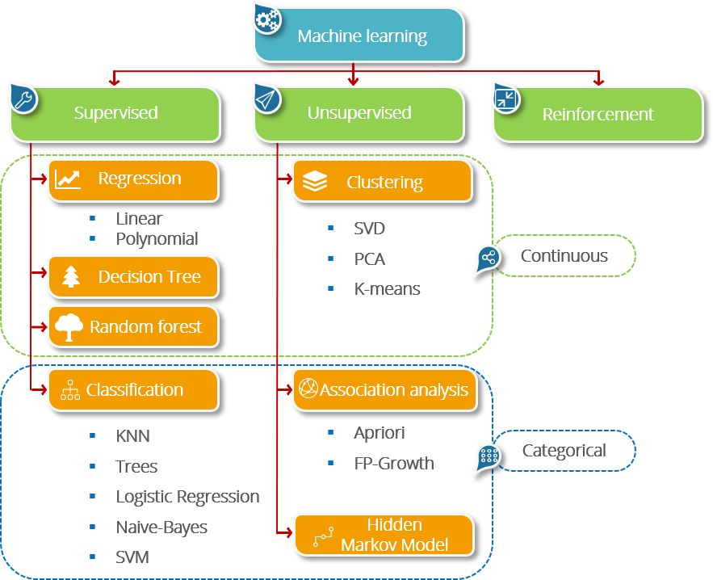
Types of ML Algorithms

Slide 11
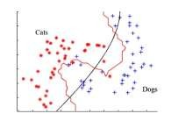
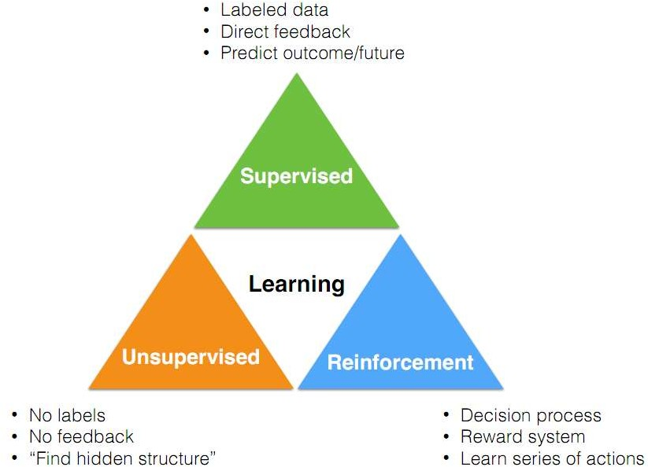
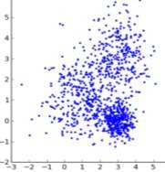
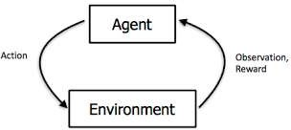
Types of ML Algorithms

Slide 12


7
Prediction Step
7 Steps of Machine Learning
6
Hyperparameter Tuning
5
Model Evaluation
4
Training the Model
3
Choosing a Model
2
Preparing Data
1
Gathering Data

Slide 13


7 Steps of Machine Learning
1
2 3 4 5 6 7
Gathering Data
Preparing Data
Choosing a Model
Training the Model
Model Evaluation
Hyperparameter Tuning
Prediction Step
Data collection is the process of gathering and measuring information on variables of interest, in an established systematic fashion that enables one to answer stated research questions, test hypotheses, and evaluate outcomes

Slide 14
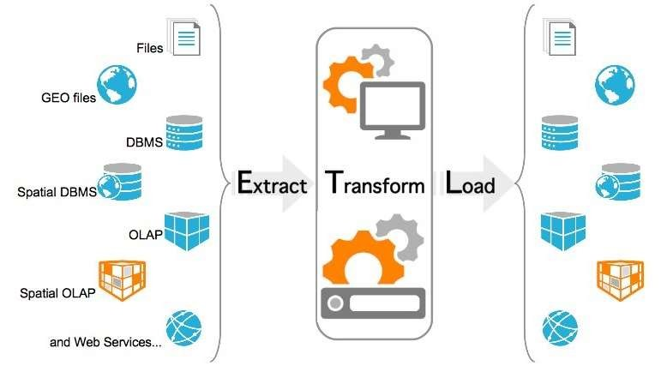
7 Steps of Machine Learning
1
Data collection is the process of gathering and measuring information on variables of interest, in an established systematic fashion that enables one to answer stated research questions, test hypotheses, and evaluate outcomes
Gathering Data

Slide 15
Data Gathering
Data type: (Un)Structured
Data may be structured or unstructured
Distribution of data
Inconsistency of incoming records
Volume
High volume of data demands scalable techniques. Incremental learning, Resource (computation and storage) issue
Sensitive information
Privacy preserving issue

Slide 16

7 Steps of Machine Learning
2
1
3 4 5 6 7
Gathering Data
Preparing Data
Choosing a Model
Training the Model
Model Evaluation
Hyperparameters Tuning
Prediction Step
Once the data is collected, it’s time to assess the condition of it, including looking for trends, outliers, exceptions, incorrect, inconsistent, missing, or skewed information.

Slide 17
Preparing Data
2
Data Exploration and Profiling
Once the data is collected, it’s time to assess the condition of it, including looking for trends, outliers, exceptions, incorrect, inconsistent, missing, or skewed information.
Formatting data to make it consistent
The next step in great data preparation is to ensure your data is formatted in a way that best fits your machine learning model. If you are aggregating data from different sources, or if your data set has been manually updated by more than one stakeholder, you’ll likely discover anomalies in how the data is formatted (e.g. USD5.50 versus $5.50).
Improving data quality
Here, start by having a strategy for dealing with erroneous data, missing values, extreme values, and outliers in your data.
Feature engineering
This step involves the art and science of transforming raw data into features that better represent a pattern to the learning algorithms.
Splitting data into training and test sets
The final step is to split your data into two sets; one for training your algorithm, and another for evaluation purposes.
Preparing Data

Slide 18
1. Data Exploration and Profiling
Once the data is collected, it’s time to assess the condition of it, including looking for trends, outliers, exceptions, incorrect, inconsistent, missing, or skewed information. This is important because your source data will inform all of your model’s findings, so it is critical to be sure it does not contain unseen biases. For example, if you are looking at customer behavior nationally, but only pulling in data from a limited sample, you might miss important geographic regions. This is the time to catch any issues that could incorrectly skew your model’s findings, on the entire data set, and not just on partial or sample data sets.
01
Incorrect and inconsistent data discovery
This is the time to catch any issues that could incorrectly skew your model’s findings, on the entire data set
02
Discover unseen bias in data
If you are looking at customer behavior nationally, but only pulling in data from a limited sample, you might miss important geographic regions.
03
Data visualization tools and techniques
Use any data visualization tools and techniques or
statistical analysis techniques to explore data

Slide 19
2. Formatting data to make it consistent
The next step in great data preparation is to ensure your data is formatted in a way that best fits your machine learning model. If you are aggregating data from different sources, or if your data set has been manually updated by more than one stakeholder, you’ll likely discover anomalies in how the data is formatted (e.g. USD5.50 versus $5.50). In the same way, standardizing values in a column, e.g. State names that could be spelled out or abbreviated) will ensure that your data will aggregate correctly. Consistent data formatting takes away these errors so that the entire data set uses the same input formatting protocols.
01
Anomalies in how the data is formatted
$50 vs USD 50
02
Formatting inconsistency in unstructured data
Two different words length and size of array results in different vectors.
03
Inconsistency checking
Inconsistent values from different sources of data

Slide 20
3. Improving data quality
Start by having a strategy for dealing with erroneous data, missing values, extreme values, and outliers in your data. Self-service data preparation tools can help if they have intelligent facilities built in to help match data attributes from disparate datasets to combine them intelligently. For instance, if you have columns for FIRST NAME and LAST NAME in one dataset and another dataset has a column called CUSTOMER that seem to hold a FIRST and LAST NAME combined, intelligent algorithms should be able to determine a way to match these and join the datasets to get a singular view of the customer.
For continuous variables, make sure to use histograms to review the distribution of your data and reduce the skewness. Be sure to examine records outside an accepted range of value. This “outlier” could be an inputting error, or it could be a real and meaningful result that could inform future events as duplicate or similar values could carry the same information and should be eliminated. Similarly, take care before automatically deleting all records with a missing value, as too many deletions could skew your data set to no longer reflect real-world situations.
01
Handling missing data
This is the time to catch any issues that could incorrectly skew your model’s findings, on the entire data set
02
Outlier removal
If you are looking at customer behavior nationally, but only pulling in data from a limited sample, you might miss important geographic regions.
03
Unbalanced data handling
Use any data visualization tools and techniques or statistical analysis techniques to explore data

Slide 21


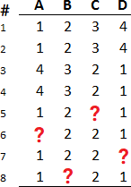
Handling missing data: notes
Deleting rows
Delete the rows with at leas one
missing value
01
04
Assigning a unique category such as ‘unknown’
Deleting Columns
Delete the columns with at leas one
missing value
02
05
Predict the missing values With the help of machine learning techniques such as regression on other features
Replacing with mean/median/mode 03
06
Using algorithms which support missing values
Like KNN, Random Forest
TECHNIQUES
Different techniques in handling missing data in machine learning research

Slide 22



Handling missing data
Performance
indicator
How much data is missing?
What kind of data is missing?
20

Slide 23


Outlier removal
What are anomalies/outliers?
The set of data points that are considerably different than the remainder of the data
Applications
Credit card fraud detection, telecommunication, fraud detection, network intrusion detection, fault detection
Anomaly Detection Schemes
General Steps: 1) Build a profile of the “normal” behavior. Profile can be patterns or summary statistics for the overall population. 2) Use the “normal” profile to detect anomalies
Non-linear
Linear
Piecewise linear

Slide 24

Outlier removal
Distance-Based Methods
Graphical Approaches Boxplot (1-D), Scatter plot (2-D), Spin plot (3-D), Chernoff faces , … Limitations: Time consuming
01
04
Clustering-Based
Cluster the data into groups of different density. Choose points in small cluster as candidate outliers. Compute the distance between candidate points and non-candidate clusters. If candidate points are far from all other non- candidate points, they are outliers
Nearest-Neighbor Based Approach Compute the distance between every pair of data points. Data points for which there are fewer than p neighboring points within a distance are outliers.
02
05
Convex Hull Method Extreme points are assumed to be outliers. Use convex hull method to detect extreme values. What if the outlier occurs in the middle of the data?
Statistical Approaches 03
Assume a parametric model describing
the distribution of the data (e.g., normal distribution). Apply a statistical test that depends on data distribution
06
Density-Based
For each point, compute the density of its local neighborhood. Outliers are points with largest difference in average local density of sample p and the density of its nearest neighbors
TECHNIQUES
Different techniques in outlier removal in machine learning research

Slide 25
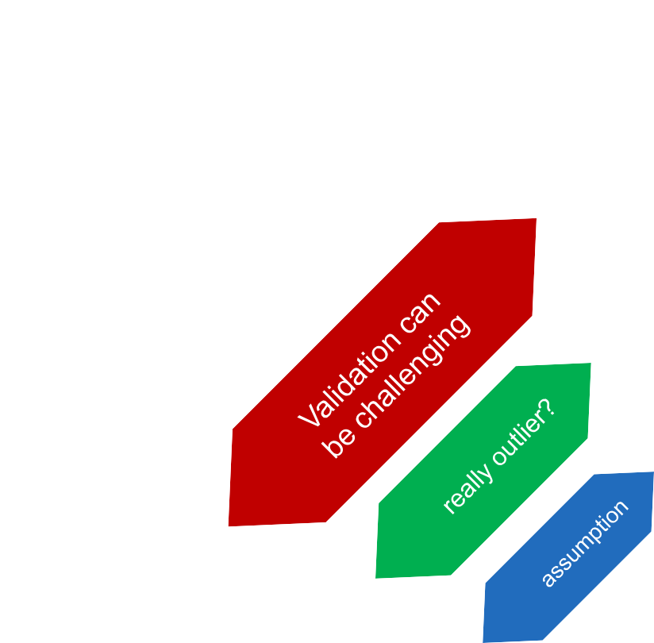
Outlier removal : notes
How many outliers
The number of outliers in dataset.
Method is unsupervised
Method is fully unsupervised. Outliers comes from data and may lead algorithm in wrong directions.
01
Validation can be quite challenging
In conjunction with next steps algorithms
02
Outlier or rare distribution of data?
03
Working assumption
There are considerably more “normal” observations than “abnormal” observations
04
05

Slide 26
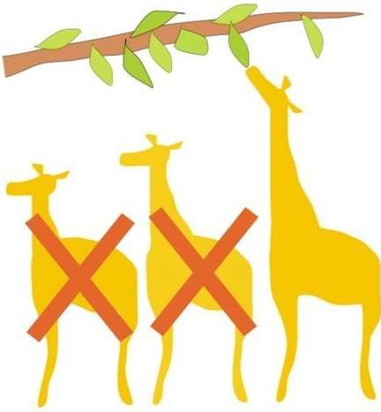
4. Feature engineering
Feature engineering is the process of using domain knowledge of the data to select features or generate new features that allow machine learning algorithms to work more accurately.
Coming up with features is difficult, time-consuming, requires expert knowledge.
Some machine learning projects succeed and some fail. What makes the difference? Easily the most important factor is the features used.
Good data preparation and feature engineering is integral to better prediction

Slide 27
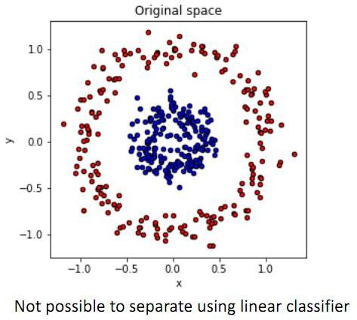
4. Feature engineering

Slide 28
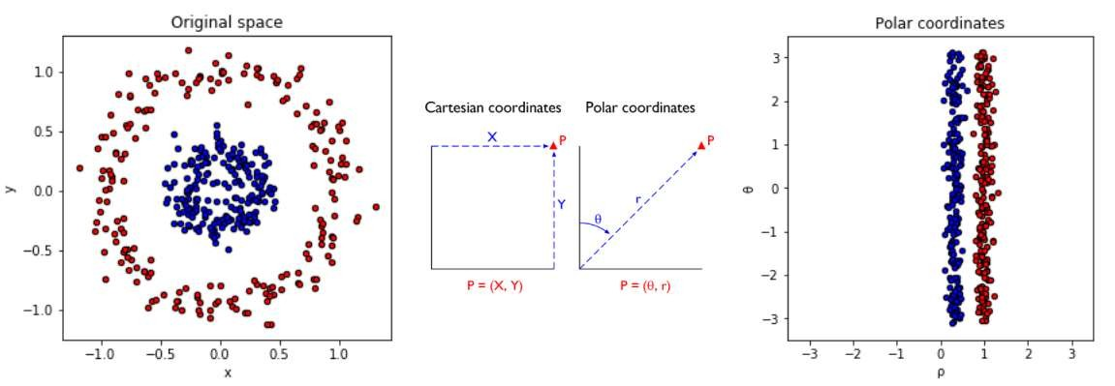
4. Feature engineering
What if we use polar coordinates instead?

Slide 29
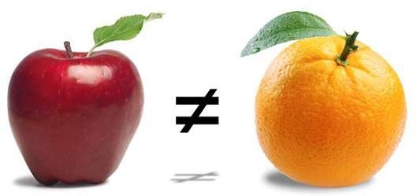
Feature generation
Feature generation is also known as feature construction or feature extraction. The process of creating new features from raw data or one or multiple features.
Three general methodologies:
Feature extraction: Domain-specific, Statistical features, predefined class of features
Mapping data to new space: E.g., Fourier transformation: wavelet transformation, manifold approaches
Feature construction: Combining features, Data discretization

Slide 30

Feature Selection
Sometimes a lot of features exist. Feature selection is the method of reducing data dimension while doing predictive analysis.
Why:
Curse of dimensionality
Easier visualization
Meaningful distance
Lower storage need
Faster computation
Two kinds of feature selection techniques
Filter Method
Wrapper Method

Slide 31
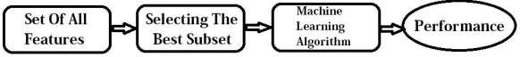
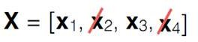
Feature Selection
Filter Method
Filter Method
This method uses the variable ranking technique in order to select the variables for ordering and here, the selection of features is independent of the classifiers used. By ranking, it means how much useful and important each feature is expected to be for classification. Removes Irrelevant and redundant features.
Statistical Test: Chi-Square Test to test the independence of two events, Hypothesis testing.
Variance Threshold: This approach of feature selection removes all features whose variance does not meet some threshold. Generally, it removes all the zero-variance features which means all the features that have the same value in all samples.
Information Gain: Information gain measures how much information a feature gives about the class.

Slide 32
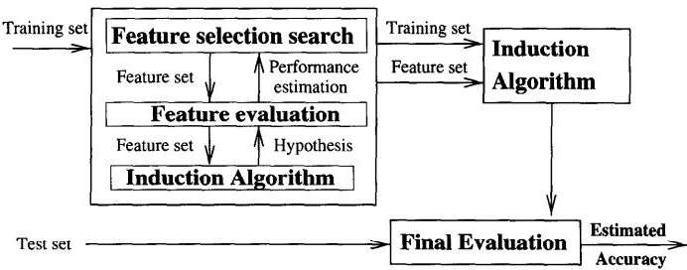
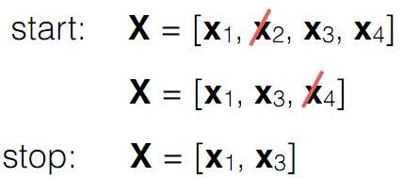
Feature Selection
Wrapper Method
In the wrapper approach, the feature subset selection algorithm exists as a wrapper around the induction algorithm. One of the main drawbacks of this technique is the mass of computations required to obtain the feature subset. Some examples of Wrapper Methods are mentioned below:
Genetic Algorithms: This algorithm can be used to find a subset of features.
Recursive Feature Elimination: RFE is a feature selection method which fits a model and removes the weakest feature until the specified number of features is satisfied.
Sequential Feature Selection: This naive algorithm starts with a null set and then add one feature to the first step which depicts the highest value for the objective function and from the second step onwards the remaining features are added individually to the current subset and thus the new subset is evaluated. This process is repeated until the required number of features are added.

Slide 33
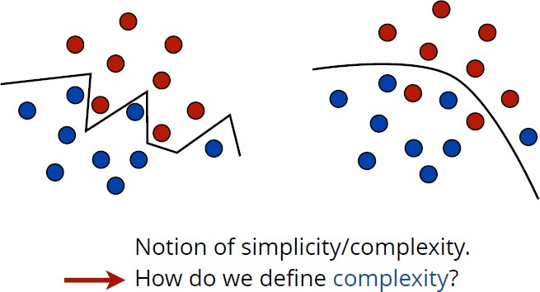
Learning ≠ Fitting

Slide 34
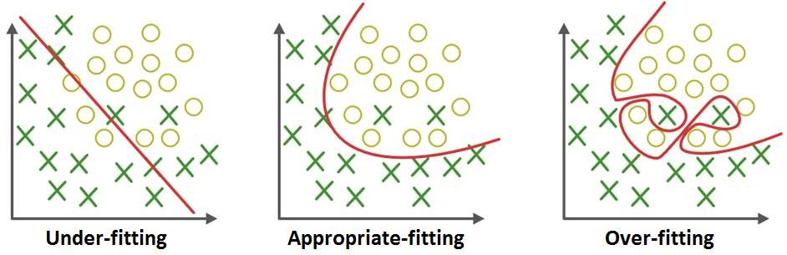
Overfitting and Underfitting
Overfitting happens when a model learns the detail and noise in the training data to the extent that it negatively impacts the performance of the model on new data.
Underfitting occurs when a model cannot adequately capture the underlying structure of the data.

Slide 35
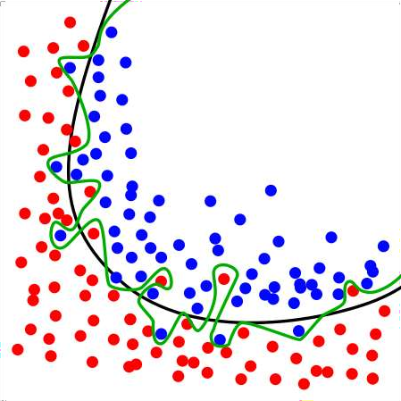
Overfitting and Underfitting
Overfitting can have many causes and usually is a combination of the following:
Overfitted
Too powerful model: e.g. you allow polynomials to degree 100. With polynomials to degree 5 you would have a much less powerful model which is much less prone to overfitting
Not enough data: Getting more data can sometimes fix overfitting problems
Too many features: Your model can identify single data points by single features and build a special case just for a single data point. For example, think of a classification problem and a decision tree. If you have feature vectors (x₁, x₂, ..., x_{n}) with binary features and n points, and each feature vector has exactly one 1, then the tree can simply use this as an identifier.
Appropriate fitted

Slide 36
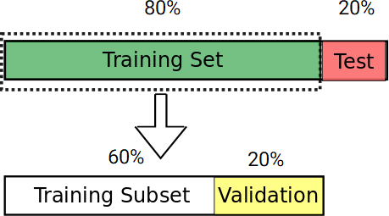
5. Splitting data
Training set: A set of examples used for learning, that is to fit the parameters [i.e., weights] of the classifier.
Validation set: A set of examples used to avoid overfitting or tune the hyperparameters [i.e., architecture, not weights] of a classifier, for example to choose the number of hidden units in a neural network.
Test set: A set of examples used only to assess the
performance [generalization] of a fully specified classifier.

Slide 37
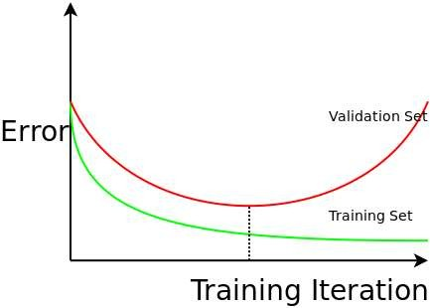
5. Splitting data
If you plot the training error, and validation error, against the number of training iterations you get the most important graph in machine learning.

Slide 38
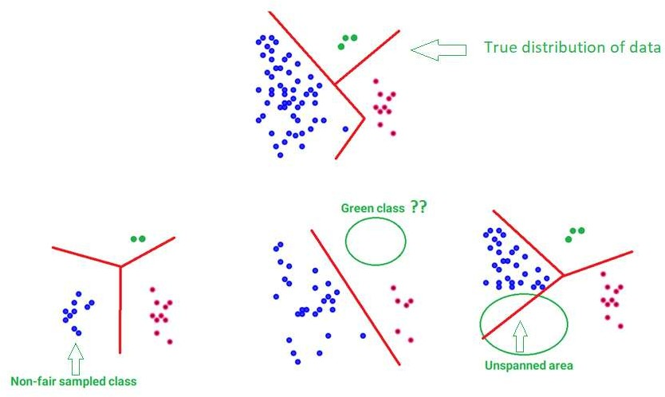
5. Splitting data: Tips
Non-fair sampling
Class imbalance problem
Unspanned area
Inappropriate sampling may results in a
wrong classification of data as the figure shows

Slide 39

7 Steps of Machine Learning
3
1
2
4 5 6 7
Gathering Data
Preparing Data
Choosing a Model
Training the Model
Model Evaluation
Hyperparameters Tuning
Prediction Step
Get a modern PowerPoint Presentation that is beautifully designed. I hope and I believe that this Template will your Time, Money and Reputation. Easy to change colors, photos and Text. You can simply impress your audience and add a unique zing and appeal to your Presentations.

Slide 40
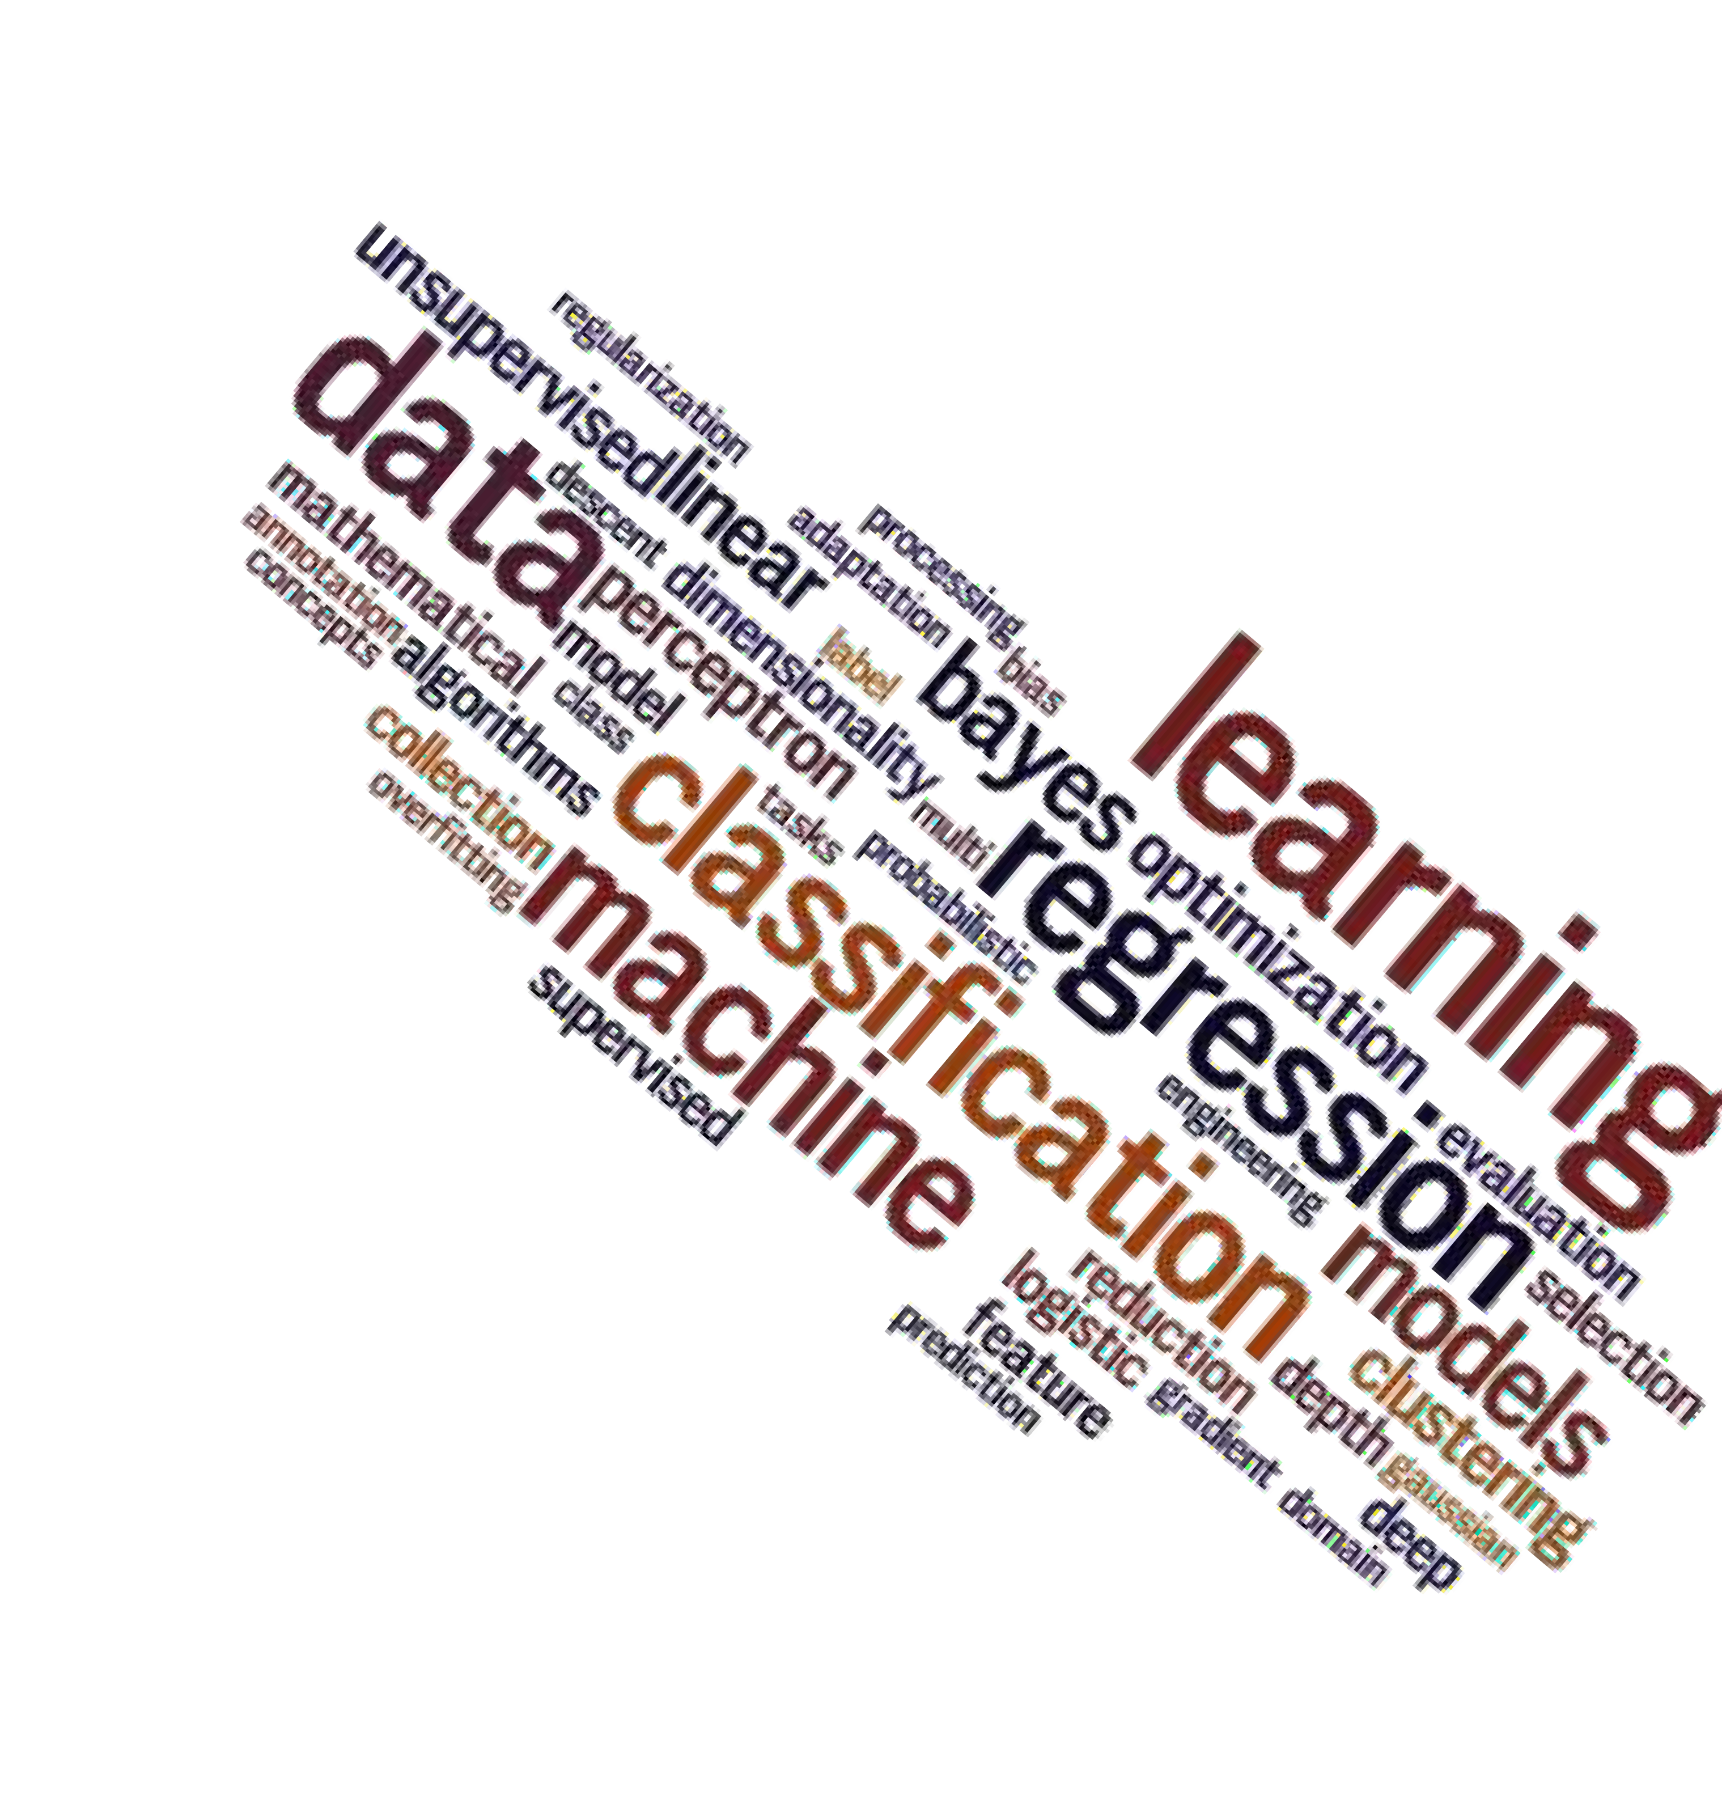
7 Steps of Machine Learning
3
Some Broad ML Tasks:
Classification: assign a category to each item (e.g., document classification).
Regression: predict a real value for each item (prediction of stock values, economic variables).
Clustering: partition data into ‘homogenous’ regions (analysis of very large data sets).
Dimensionality reduction: find lower-dimensional manifold preserving some properties of the data.
Semi-supervised learning: use existing side information during learning
Choosing a Model

Slide 41
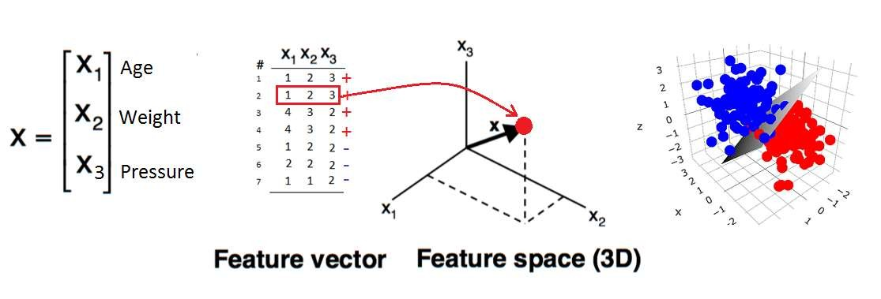
Classification
Different techniques:
Decision Tree Induction
Random Forest
Bayesian Classification
K-Nearest Neighbor
Neural Networks
Support Vector Machines
Hidden Markov Models
Rule-based Classifiers
Many More ….
Also Ensemble Methods

Slide 42
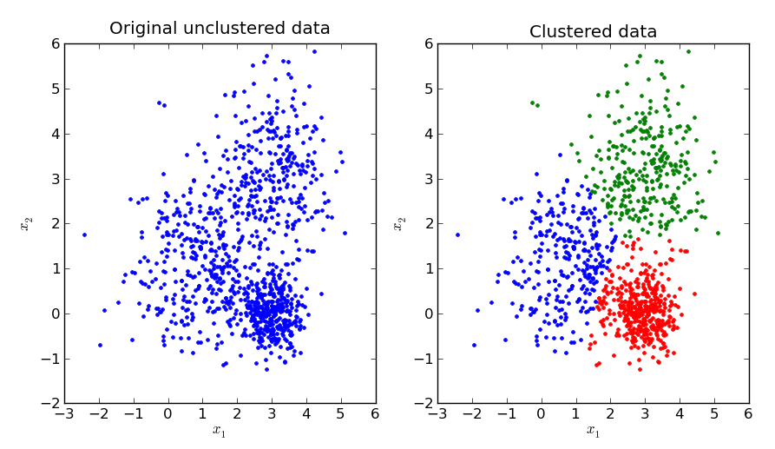
Clustering
Clustering is a method of unsupervised learning and is a common technique for statistical data analysis used in many fields.
In Data Science, we can use clustering analysis to gain some valuable insights from our data by seeing what groups the data points fall into when we apply a clustering algorithm.

Slide 43
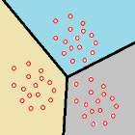
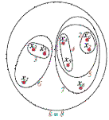
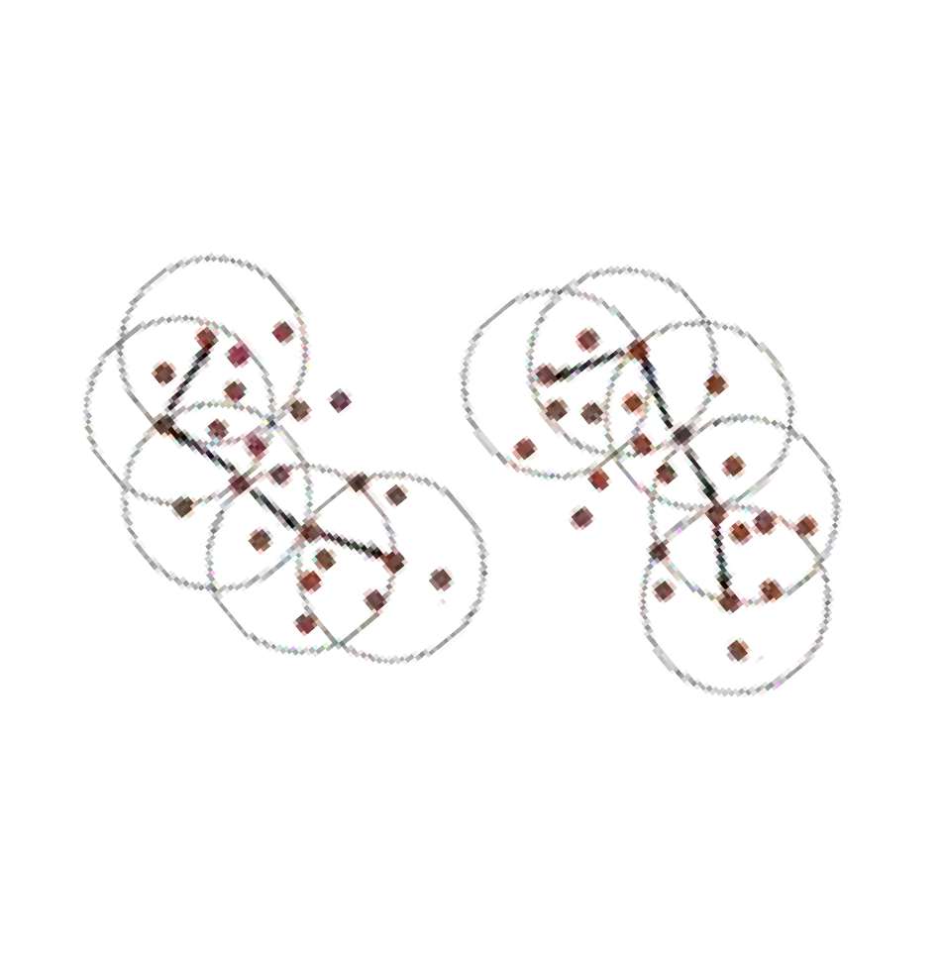
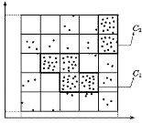
Clustering: different techniques (1)
Partitioning approach:
Construct various partitions and then evaluate them by some criterion, e.g., minimizing the sum of square errors
Typical methods: k-means, k-medoids
Hierarchical approach:
Create a hierarchical decomposition of the set of data (or objects) using some criterion
Typical methods: Diana, Agnes, BIRCH
Density-based approach:
Based on connectivity and density functions. Typical methods: DBSACN
Grid-based approach:
Based on a multiple-level granularity structure. Typical methods: STING
48

Slide 44
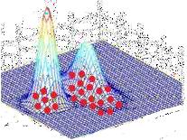
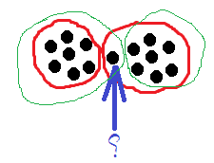
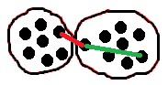

Clustering: different techniques (2)
Model-based:
A model is hypothesized for each of the clusters and tries to find the best fit of that model to each other. Typical methods: EM, SOM
Fuzzy Clustering:
Based on the theory of fuzzy membership. Typical methods: C-Means
Constraint-based:
Clustering by considering user-specified or application-specific constraints. Typical methods: constrained clustering
Graph-based clustering:
Use the theory of graph to group data in clusters. Typical methods: Graph-Cut
Subspace Clustering
Spectral Clustering
Consensus Clustering
49

Slide 45

7
Prediction Step
7 Steps of Machine Learning
6
Hyperparameters Tuning
Training the constructed model by
using test and validation sets
5
Model Evaluation
4
Training the Model
3
Choosing a Model
2
Preparing Data
1
Gathering Data

Slide 46

7 Steps of Machine Learning
4
Training the Model

Slide 47

Evaluating machine learning algorithm is an essential part of any project.
7
Prediction Step
7 Steps of Machine Learning
6
Hyperparameters Tuning
5
Model Evaluation
4
Training the Model
3
Choosing a Model
2
Preparing Data
1
Gathering Data

Slide 48
7 Steps of Machine Learning
5
Evaluating machine learning algorithm is an essential part of any project.
Different measures exist to evaluate trained models such as accuracy, TPR, FPR, F-Measure, precision, recall, …
Model Evaluation

Slide 49

7 Steps of Machine Learning
3 4
6
1
2
5
7
Gathering Data
Preparing Data
Choosing a Model
Training the Model
Model Evaluation
Prediction Step
Hyperparameters Tuning
The process of searching for the ideal model architecture is referred to as hyperparameter tuning.

Slide 50
7 Steps of Machine Learning
6
When creating a machine learning model, you'll be presented with design choices as to how to define your model architecture.
Hyperparameters Tuning
Parameters which define the model architecture are referred to as hyperparameters and thus this process of searching for the ideal model architecture is referred to as hyperparameter tuning.
These hyperparameters might address model design questions such as:
What degree of polynomial features should I use for my non-linear model?
What should be the maximum depth allowed for my decision tree?
What should be the minimum number of samples required at a leaf node in my decision tree?
How many trees should I include in my random forest?
How many neurons should I have in my neural network layer?
How many layers should I have in my neural network?
What should I set my learning rate to for gradient descent?

Slide 51

Predict the quality of results in this step
7
Prediction Step
7 Steps of Machine Learning
6
Hyperparameter Tuning
5
Model Evaluation
4
Training the Model
3
Choosing a Model
2
Preparing Data
1
Gathering Data

Slide 52
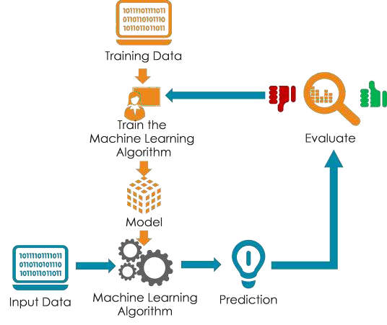
7 Steps of Machine Learning
7
Predict unseen data by the trained model
Prediction Step

Slide 53
Practice Coverage Prediction
With Google Colab

Slide 54
Thank You

